Slide 1
Analysis of Long-term care in Senior Housing.
Group-11
Deep Johal - 0787880
Mahesh Bhanudas Gujarathi - 0791269
Rugveda Rajendra Shirgaonkar - 0780896
Kavya Vijay - 0789148
Julie Kunnuvila Thomas - 0792998
Github link : https://github.com/mahesh0183/Senior_Care_Housing.git

Slide 2
Table of contents
Preprocessing
Summary of findings
Tools and Techniques
Challenges
Future Plans
Conclusion
Introduction
Problem Statement
About the Company
Goals
Objectives
Data

Slide 3
Introduction
Senior Housing plays a really important role in modern healthcare .
Senior Housing provides the crucial care needed by the senior citizens under one roof.
As a society , we should focus on building a safer environment for our elders .
This project , we aim to use our findings and identify how we can satisfy the need of more senior housing in the province of Ontario.

Slide 4
Problem Statement
Provision of senior housing communities is a complex issue. It requires thorough analysis to understand the challenges and opportunities for improvement.
At the time of emergencies , senior citizens don’t have the minimal help our seniors need. Due to the covid-19,Seniors started moving into senior homes.
With having more seniors' homes with several services, We can provide a better healthcare and assistance .

Slide 5
The waiting period after applying and getting a room in a senior
home is over a year .
This migration in turn increases the demand of building new senior homes. The availability rate is getting lower.
This needs to be addressed because the need for senior homes has the same priority as those given to building new hospitals and rehabs.

Slide 6
About the company
MECP specializes in manufacturing affordable medical equipment in Canada.
They are expanding business to provide products for long term Care housing.
Currently, MECP is trying to understand the market feasibility of their products and services in senior housing.

Slide 7
Goals
The goal of this analysis is to
understand the current state of long-term care in senior housing communities and prove that we need more senior housing in future.
identify key challenges and opportunities
develop recommendations for improving the provision of long-term care services to meet the needs of older adults.

Slide 8
Objectives
Identify the population growth of senior citizens in Canada to understand the estimate of senior housing required in Canada.
Identify the cost estimation and vacancies of senior housing in Ontario.
Convey this relation of population growth and senior housing increase to MECP, which could give them more insights about the budget and marketing scope of the senior housing market in Canada.

Slide 9
Dataset
Population estimates by age and sex of ontario and canada- This data contains the population by age groups of male, female and both the sexes from the year 2018 to 2022 in Ontario as well as canada
https://www.cmhc-schl.gc.ca/en/professionals/housing-markets-data-and-research/housing-data/data-tables/rental-market/seniors-rental-housing-canada-provinces-metropolitan-areas This data contains the information about the standard space vacancy rate and average rent for standard space.
Senior housing survey Data of ontario- This data set contains the information about vacancy rates,rents, universe counts,services and amenities of senior housing in different cities in ontario
Population estimates of Canada from World bank. - This is a part of open data published by World Bank. It has various estimates and data about GDP, Sex ratio, Employment rate, etc globally. We decided to keep our scope of usage specific to Canada with Population estimates.

Slide 10
Preprocessing
Working on data cleaning . The dataset available covers mostly all parts of Ontario but mainly focusing on south western .
Categorical features which are defined set of values and Numerical features where the values are continuous in our dataset.
focusing on data Quality assessment where we are handling missing values in the data.
few values are suppressed for confidentiality / statically reliability by taking as a zero count or no Universe.
data had few duplicate values of one another, in this case we are removing data object an advantage or bias in order to process of dealing with duplicates.

Slide 11
Summary of Findings

Slide 12
2018
2019
2020
2021
2022
Population of 65 and above age group in ONTARIO
2,512,374
2,685,008
2,423,015
2,774,242
2,600,685
The percentage of population over 65 and above age group in Ontario, Canada is increased around 2% over the years, based on our findings :
16.5% in 2018
18.36% in 2022

Slide 13
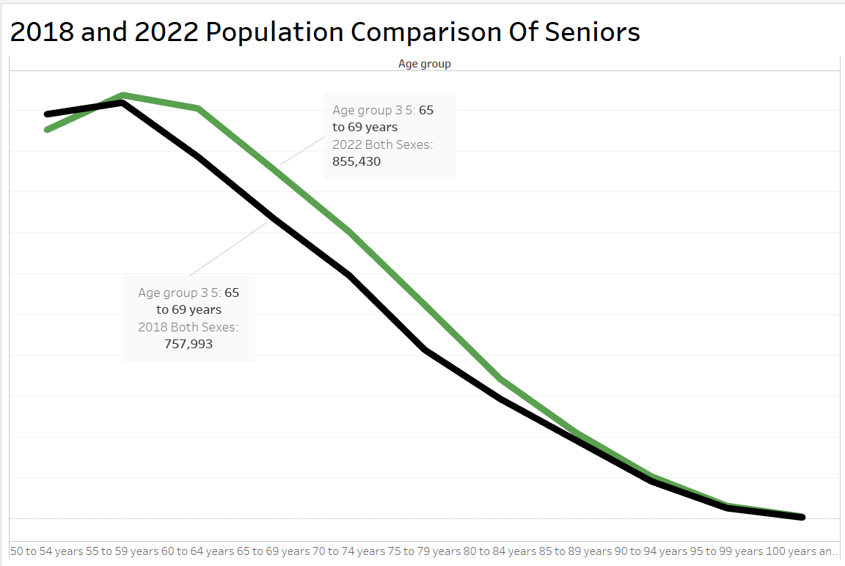
This graph is the demonstration of population comparison of Seniors in Ontario in 2018 and 2022.
Age groups from 50 to 100 years has divided with 5 years interval
Its evident that the age group 50 to 59 is almost the same in 2018 and 2022.
It can be seen that people aged over 65 has been significantly increased over the years,
2022
2018

Slide 14
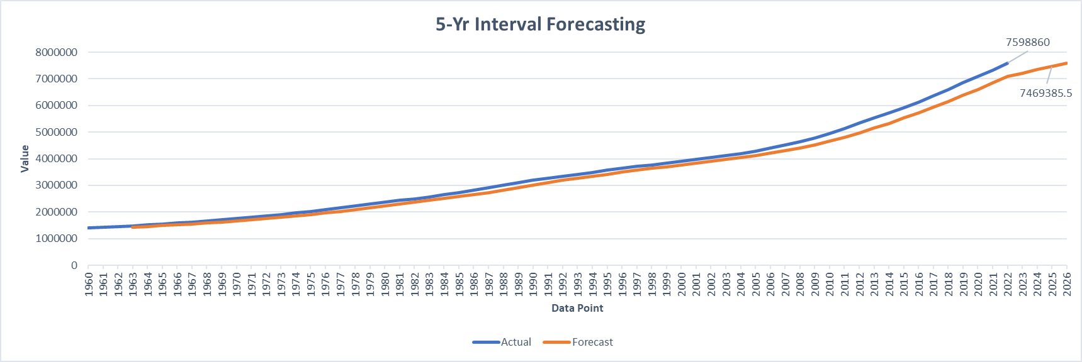
Population forecasting of 65 and above of Canada
This is a representation of population of 65 and above of Canada. The Actual population by 2023 is 7598860.
The orange line represents the moving average forecast of population. It is evident that the real population is higher
than the average overall. It is safe to assume the population would grow in the coming years over the average.

Slide 15
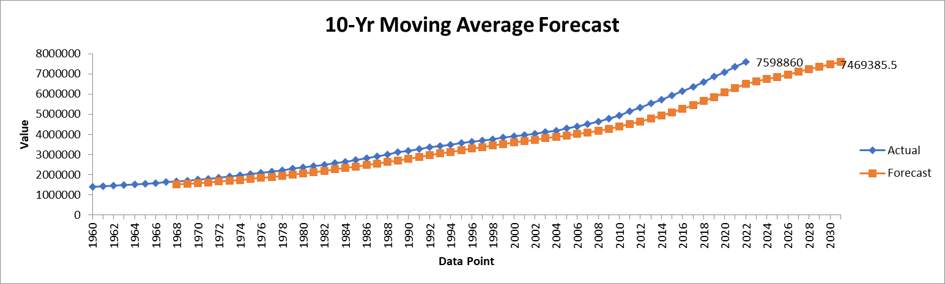
We are planning to perform the same analysis on the thee income this group so that we will get and idea on how
much they can spent on staying in long term care an senior housing

Slide 16
Tools and Techniques
Microsoft office(word ,excel, powerpoint )
Python(numpy , pandas, matplotlib )
Tableau
Power BI

Slide 17
Challenges
Understand various datasets
Data collection was challenging in long term care as it often involves sensitive personal information and ensuring the privacy and confidentiality of participants.
Merging the datasets into one dataset
Difficulty in cleaning the datasets due different data sizes.

Slide 18
Future Plans
Combine all the results into a dashboard which can show the population growth of the seniors.
Find Income and population of senior citizens and the vacancies available in long term residents.
This will show an overall picture of seniors and how many senior homes we needs as per our finding. Also we would derive the affordability of residence, this would help identify the budget available for residence and the company can identify their market strategies.
Make final report and convey all information.

Slide 19
Conclusion
95% of Health's survey respondents report a visit with a primary medical care provider within the previous six months.
• Access to safe, affordable housing and a supportive living environment promotes stability, wellness .
• Geriatric care is best provided by an interdisciplinary team.
• The pool of geriatric specialists in all disciplines is insufficient to meet current needs and is not expected to increase significantly despite increasing demands over the next quarter century
• All health care professionals, thus, need to learn the basic principles of geriatrics and acquire core clinical skills in the care of the older patient

Slide 20
Thank You!

